Slide 1
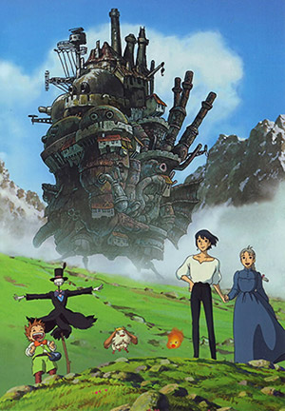
Pacifism in Howl’s Moving Castle
BY EMMA & LEAH

Slide 2
Introduction
Militarism describes the belief that a country should maintain a strong military capability and be prepared to use it aggressively to defend or promote national interests. Howl’s Moving Castle is an anime film created by Hayao Miyazaki which was produced in 2004 that highlights and explores the ideas of pacifism. Pacifism the belief that war and violence are unjustifiable and that all disputes should be settled by peaceful means. The strong female protagonist Sophie, has an uneventful life but it changes when she befriends a wizard named Howl, who lives in a magical castle. The evil Witch of Waste takes issue and casts a spell on young Sophie, which ages her prematurely and Howl must use all his magical talents to battle the witch and return Sophie to her former youth whilst fighting a destructive war. The movie is related to Miyazaki’s anti-war philosophy in the post-9/11 political context and the ensuing US-led War on Terror, especially the 2003 Iraq War. The idea of pacifism is displayed throughout the film through the use of technical codes, symbolism and rule of thirds.

Slide 3
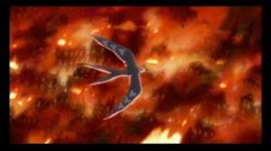
Mise-en-scene
Howl’s as a bird
  He's soaring over the destruction that is left behind by the battle ships that are from the neighbouring kingdom
  Fighting the battle ships to stop them from destroying the town and kingdom
Flames
  Destruction left behind from the battle ship from the neighbouring kingdom. Howl is soaring over it and viewing the destruction.
Howl is flying above the flames. Miyazaki has used this to segregate Howl from the war below him.

Slide 4
Impact of language and structural choices on shaping your own and others interpretation
The impact of language and structure affects the way that people interpret the film and the way they see things affects their conceived meaning.
Structure is the same
  Plot
    Epilogue: introduced to the characters and the start of the story
    Complication: starts to get complicated
    Conflict: tarts to heat up and audience/viewer/reader starts to see a major problem
    Climax: height of the plot,
    Resolution: everything is put in its place and a happy ever after

Slide 5
How anime film has a different text type and shapes audience response.
Different from normal Japan
  Less formal
Slang
  Able to understand it more/ relate to it more as we use slang more than formal language
  This particular film creates a dominant viewing toward pacifism.

Slide 6
Definitions
Nationalism: The strong belief that the interests of a particular nation-state are of primary importance. Also, the belief that a people who share a common language, history, and culture should constitute an independent nation, free of foreign domination.
Militarism: describes the belief that a country should maintain a strong military capability and be prepared to use it aggressively to defend or promote national interests
Nihilism: the rejection of all religious and moral principles, in the belief that life is meaningless

Slide 7
Symbolism
Howl turning into a bird
  Howl's pure-hearted anti-war stance is presented as nihilism with no alternative as he fights forces from each side and becomes the worst terror of all, in the form of the monstrous bird.
  By transforming into the bird, Howl risks losing his own humanity. Calcifer comments at one point that he will soon not be able to return to human form,
  The scarecrow- Sophie seems to feel some odd affection for this scarecrow because she herself is feeling abandoned and homely.

Slide 8
The ways attitudes, ideas and voices are represented
In the movie, Madame Suliman appears to have only sadistic motivations for creating conflict is unable to recognize the idiocy of the war until the very end of the story. This reflects Miyazaki's desire to show real-world conflicts as also being somewhat random and fuelled by the desires of impulsive people.
Howl is a pacifist at heart and interferes in the war by transforming himself into a large bird of prey and fights off strange creatures. It is seen that he never kills, only fights for self defence and protection of others.

Slide 9
The ways attitudes, ideas and voices are represented
The featured idea of pacifism is represented through attitudes and voices. These include the voice of Sophie, who verbalises her absolute pacifism and fully opposes war. Sophie, who believes that it is better for Howl to be a coward, tries to stop Howl from going to war.
Miyzaki utilises Wizard Howl as a character to convey pacifism. Howl hates and fears dying and killing. In a scene where Sophie sees a military airship, Sophie asks Howl whether they are enemies or not, and Howl replies that it makes no difference because they are all ‘murderers'. In this scene, Howl shows his strong disgust for the war killing innocent people.

Slide 10
Critically analysing how and why the text positions and influence viewers.
In Howl’s Moving Castle metaphor and allegory are used as techniques of story-telling to tell two stories in one, the literal one of a magical fantasy to both hide and reveal another story with a totally different meaning. Characters which viewers sympathise with, eg Sophie and Howl, show their pacifistic views, hence influencing viewers to feel the same way.
The use of colour and symbolism also depict pacifism as dark reds, black and browns are used to portray war, and these colours are also associated with death horror and destruction. The bell above the Howl’s door has respective colours which are commonly identified with similar emotions. Black with the wasteland/battle field and pick with Sophie’s calming garden.

